Slide 1

Balanced scorecard slide 1
Decentralized System to Compute the Safest Route
Presented By-
Anushka Patil, Keyur Mehta, Snehal Vyawahare

Slide 2
Project Background
Communities are adversely affected by social harm events- crime, traffic crashes, medical emergencies, drug use, etc.
Based on CDASH project.
Where they provide simulation results using data provided by the Indianapolis Metropolitan Police Department to illustrate the Hawkes process model of social harm over recently introduced social harm incidences.
Reference: http://cdash.cs.iupui.edu/index.html

Slide 3
AS-IS Solution/ Problem Statement
Services like Google Maps are excelled at finding the shortest, most direct routes from Point A to Point B.
It uses real-time traffic conditions for computing the fastest route.
Crowd-sourced traffic data is used to give the users the quickest route.
The time of journey as the only factor of consideration is not a sufficient metric in today’s times.
Parameters like road safety and time of travel must be considered for computing the best possible route.

Slide 4
Implemented Solution
The overall idea here is to avoid dangerous spots on city streets while moving from one place to another.
Algorithms for getting from one place to another the shortest path, the safest path.
This backend model relies both on crime data, when it’s available, and crowdsourced comments to reveal potential trouble spots to users.
Fig 1.0. Implementation solution

Slide 5
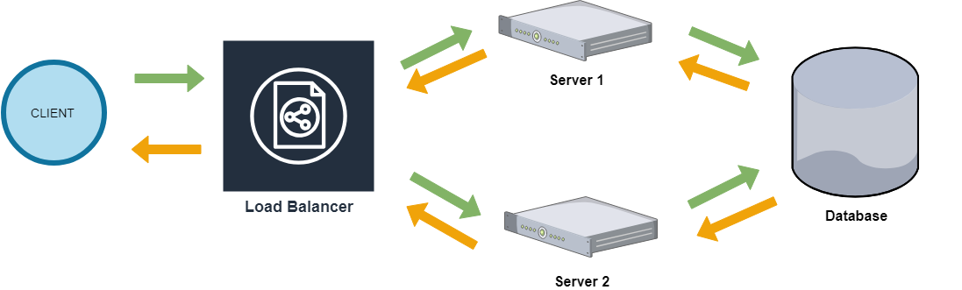
Architecture Design
Fig 2.0. Architecture Design

Slide 6

Design Decisions
Load Balancer:
Delegate the request to either of the servers.
Redirecting to the backup server in case of failures.
Application Server:
Compute the safest shortest route.
Database Server:
Maintain and/or retrieve the crime data.
Backup Server:
Manages all the responsibilities of an application server in case of failure.

Slide 7
Tools/Technology Used
Programming Language : Java
Communication Paradigm: Java RMI
Machines:
Components | Machines
Client | Tesla.cs.iupui.edu
Load Balancer | Rain.cs.iupui.edu
Servers | Thunder.cs.iupui.edu, Lightning.cs.iupui.edu
Database | in-csci-rrpc01.cs.iupui.edu

Slide 8
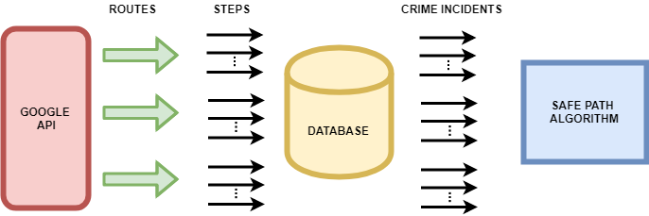
Algorithm
Fig 3.1. Algorithm: Extraction of crime data

Slide 9
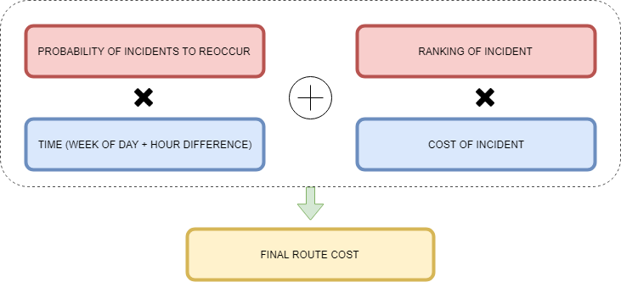
Algorithm
Fig 3.2. Algorithm: Final route cost computation

Slide 10
Implementation Details
It pulls out available crime data with in 1 mile of the GPS co-ordinate with parameters like time, date, location and types of crime.
The Safe Path algorithms calculates the total risk of a path from one place to another and returns the safest and shortest path.
The selection of the Safest Shortest Route is based on:
If the differences between the cost of the safest route and the shortest route is less than 15%, than is not recommended.
If the difference is greater than 15%, the safest route is recommended.

Slide 11
Distributed Concepts
It is rightly said that "Failure happens all the time.“ So when design, you design for failures.
Availability
If one server fails the load balancer redirects the client request to the backup server
Distributed Nature
Separation of concern - Application, DB and Load Server
Fault Tolerance
Concurrency
Simultaneous access for different clients.
Server Crash – client retry requests
Invalid Requests – new requests

Slide 12
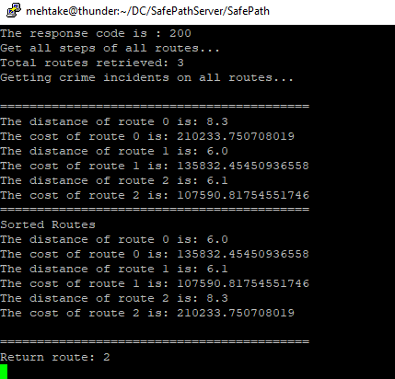
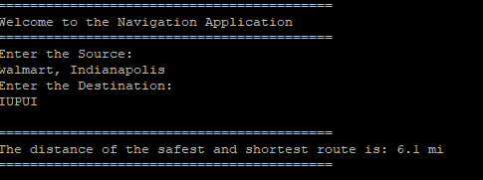
Results Obtained
Case 1. Safest Route

Slide 13
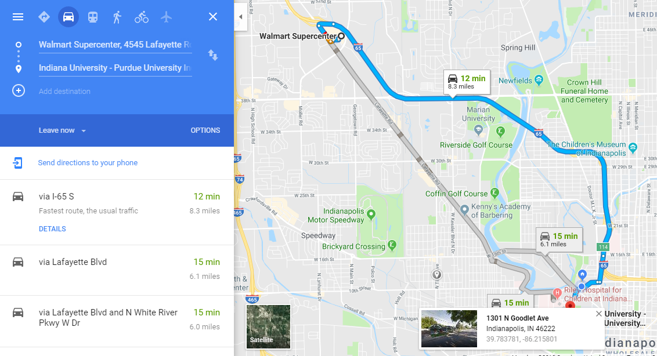
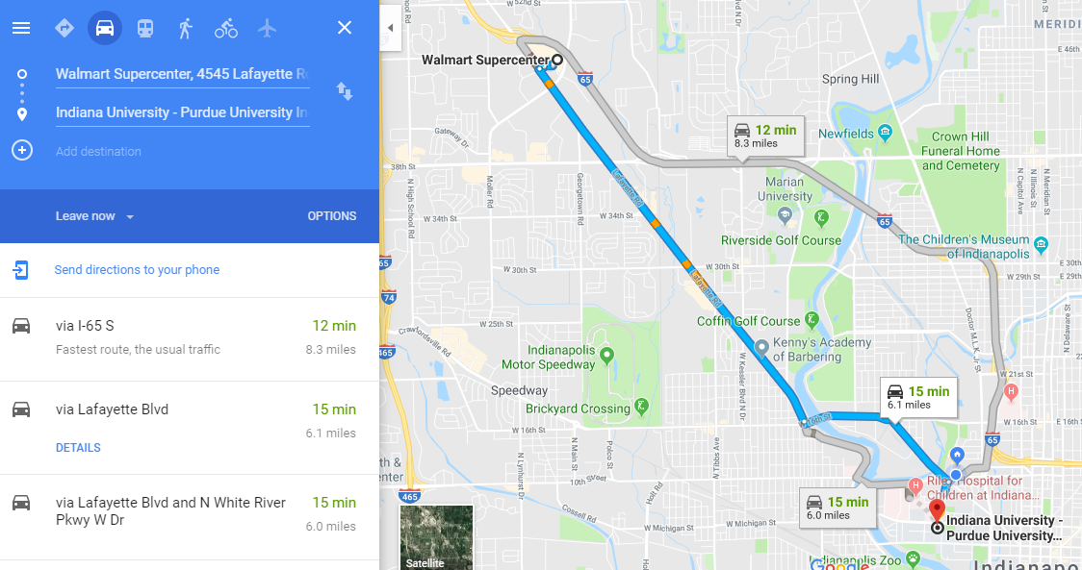
Results Obtained
Safest Route
Google

Slide 14
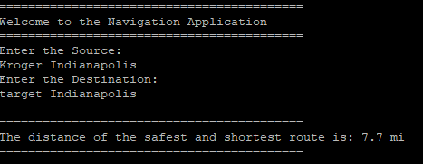
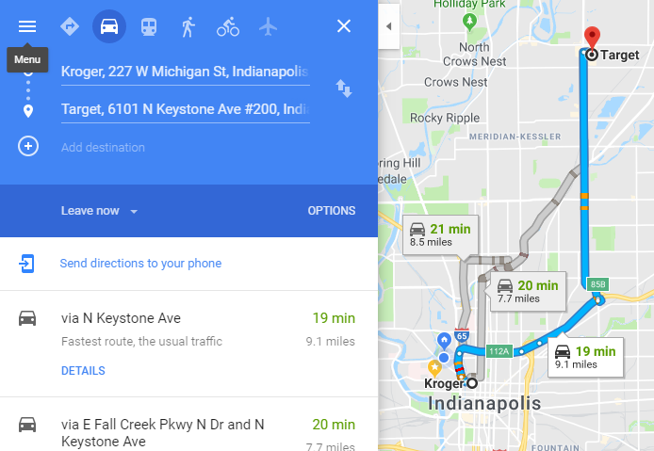
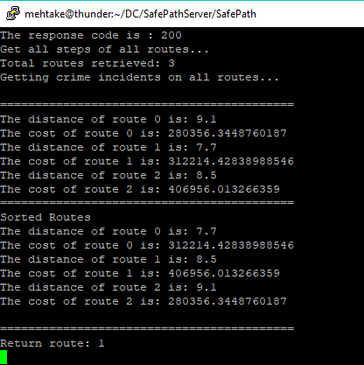
Results Obtained
Case 2. Risk Cost difference is Less than 15%

Slide 15
Conclusion
Calculate the total risk of path from one point to another.
The model can be add on to the existing navigation tool.
Make commute safe and cities more livable.

Slide 16
Demo

Slide 17
Balanced scorecard slide 10
THANK YOU

Slide 18
References
CDASH Paper: https://pdfs.semanticscholar.org/e885/b56c61577d4d8d7c38284c63883827d3ad14.pdf
Google API: https://developers.google.com/maps/documentation/directions/start
Java RMI: https://docs.oracle.com/javase/tutorial/rmi/index.html

